Slide 1


Marwadi Education Foundation’s Group of Institutions Faculty of Computer Applications MCA Sem- I
Fundamental of Java Programming
Unit – 3
Wrappers

Slide 2
Introduction to Wrapper Class
A wrapper class in Java is a class that provides an object representation for the eight primitive data types. The primitive types in Java (such as int, char, boolean, etc.) are not objects, but sometimes it's necessary to work with them as objects. This is where wrapper classes come in.
Key Uses and Needs of Wrapper Classes
Object Representation:Wrapper classes provide a way to use primitive data types as objects. This is useful when you need to store primitive values in collections like ArrayList, HashMap, etc., which work only with objects, not primitives.

Slide 3
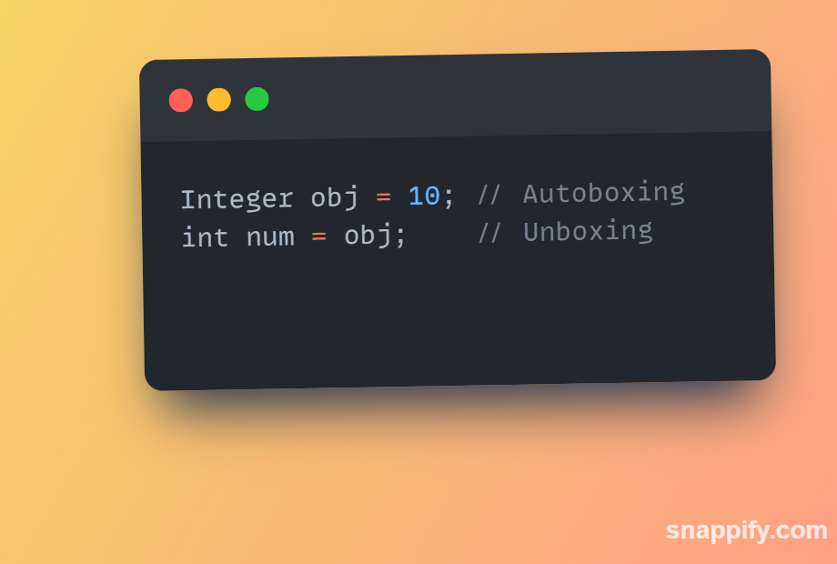
Introduction to Wrapper Class
Autoboxing and Unboxing:
Autoboxing is the automatic conversion of a primitive type into its corresponding wrapper class by the Java compiler.
Unboxing is the reverse process, where an object of a wrapper class is automatically converted to its corresponding primitive type.

Slide 4
Introduction to Wrapper Class
Utility Methods:Wrapper classes provide utility methods to work with primitive types.
For example, Integer.parseInt("123") converts a String to an int, and Character.isDigit('1') checks if a character is a digit.
Immutable Objects:Wrapper class objects are immutable, meaning their values cannot be changed once created. This immutability is beneficial in maintaining data integrity.
Ex1:

Slide 5
Introduction to Wrapper Class

Slide 6
Various Methods of Wrapper Class
Method | Description
Conversion from Primitive Numbers to Object Numbers
Integer I = new Integer(i) | Primitive integer to Integer Object
Float F = new Float(f) | Primitive float to Float Object
Double D = new Double(d) | Primitive double to Double Object
Long L = new Long(l) | Primitive long to Long Object
Conversion from Object Numbers to Primitive Numbers
int i = I.intValue() | Object to primitive integer
float f = F.floatValue() | Object to primitive flaot
long l = L.longValue() | Object to primitive long
double d = D.doubleValue() | Object to primitive double

Slide 7
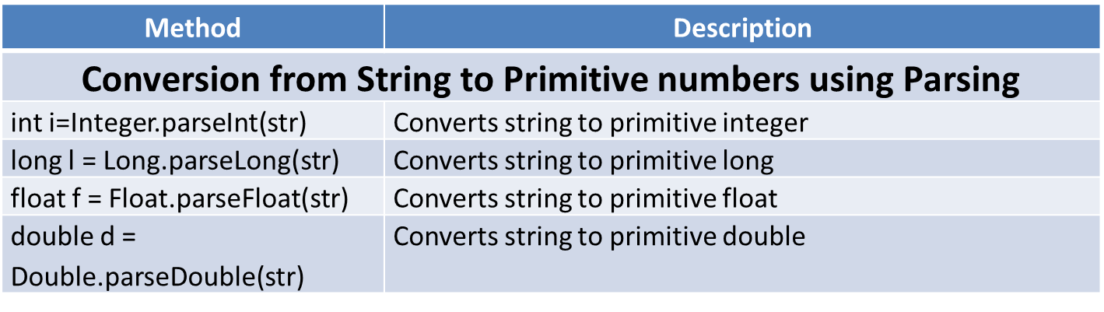
Various Methods of Wrapper Class
Method | Description
Conversion from Number to String
str=Integer.toString(i) | Primitive integer to string
str=Float.toString(f) | Primitive float to string
str=Double.toString(d) | Primitive double to string
str=Long.toString(l) | Primitive long to string
Conversion from String to Number Objects
D=Double.valueOf(str) | Converts string to Double Object
F=Float.valueOf(str) | Converts string to Float Object
I=Integer.valueOf(str) | Converts string to Integer Object
L=Long.valueOf(str) | Converts string to Long Object

Slide 8
Various Methods of Wrapper Class
The parseInt method is a static method provided by the Integer wrapper class in Java. It is used to convert a String representing an integer value into its corresponding primitive int type.
Use Cases for parseIntUser
Input: When reading numeric input as a string from the user (e.g., from a console or text field) and converting it to an integer for processing.
Data Conversion: When working with data sources (like files or databases) where numeric values are stored as strings.
String to Number Conversion: Whenever you need to convert a numeric string to an integer for arithmetic operations.
Ex1:

Slide 9
Thank You

